Slide 1
Database System (CS 406)
Lecture 02
Background of Databases
Ms. Rabia Gul
Lecturer, ITC

Slide 2
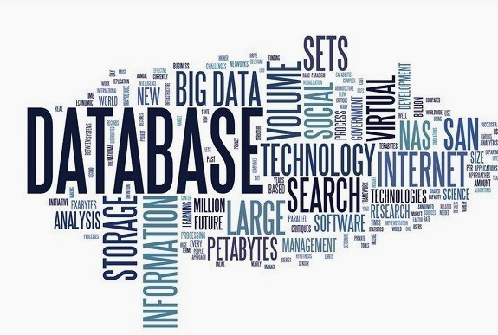
Background of Databases

Slide 3
Traditional File-Based System
Before the use of a computer, a manual file system was
used to maintain the records and files.
After the emergence of computers, data were stored and processed using a traditional file system and it makes it easy to find any information.
In this traditional file system, each file is independent of other file and data in the different file can be integrated only by writing an individual program for each application.
Sometimes, it is not possible to identify all the programs using data and identified on trial and error basis. All functional areas in the organization create, processes its own files.

Slide 4
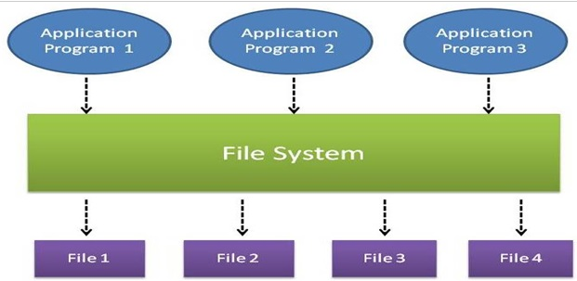
Traditional File-Based System

Slide 5
Traditional File-Based System
Advantages of Traditional File-Based System
Simple to use.
Less complex.
Minimal investment
No requirement of the specialist.

Slide 6
Traditional File-Based System
Disadvantages of Traditional-Based File System
Data redundancy (Each application has its own data file so, same data may have to be recorded and stored in many times).
Data inconsistency (Due to the same data items that appear in more than one file do not get updated simultaneously in each and every file).
Data dependence (Program and application in the file processing system are data dependent but, the problem is incompatible with file format).
Limited data sharing.
The problem with security.

Slide 7
Traditional File-Based System
Disadvantages of Traditional File-Based System
Retrieval (retrieval is not easy).
Time-consuming.
Inefficient to maintain the record of the big firm having a large number of items.
Required Lots of labor work to do.

Slide 8


